Slide 1
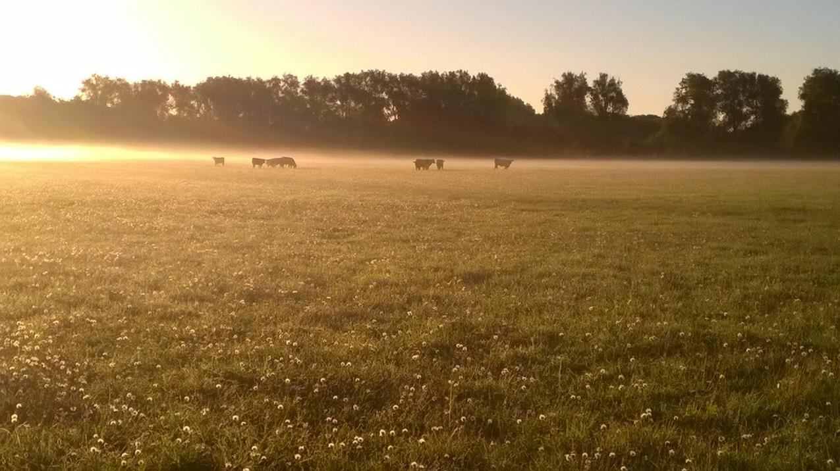
Oxford deserves a better flood scheme
Public Meeting Oxford Town Hall
17 April 2023
Community comment on Regulation 25 Consultation

Slide 2
Introduction and
The Costs and Benefits of the
Oxford Flood Alleviation Scheme
Tim O’Hara
Surveyor and North Hinksey resident

Slide 3
Oxford Flood Alleviation Scheme
Defences at Botley Road, New Hinksey & South Hinksey
Osney Mead Defence
Channel improvements on Seacourt Stream & under A432
Control structure on Eastwyke Ditch
New/raised bridges at Willow Walk, Devils Backbone, N Hinksey Causeway, Old Abingdon Road, Kennington Road
Network Rail culvert
Network Rail clearance of Stroud’s Bridge
Clearance of Munday’s Bridge.
Temporary defences at Osney Island & New Hinksey
Bank raised at Redbridge Stream
… and a 5km channel

Slide 4
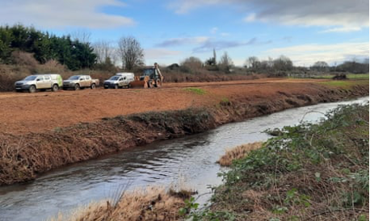
The flood channel will cause environmental damage and incur social costs because of its:
Size: 400,000m3 (700,000 tonnes) of material excavated.
Route: 5km. From North of Botley Rd to South of Old Abingdon Rd via Hinksey Meadow.
3 year (or more) construction period.
Post construction appearance and characteristics

Slide 5
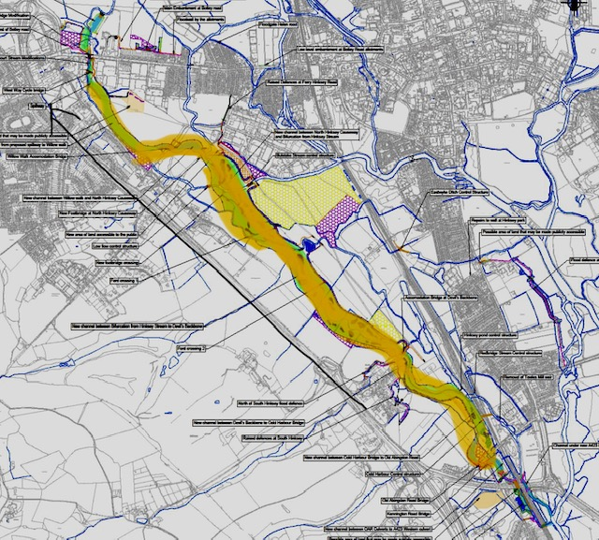
Proposed flood channel – central section highlighted in yellow

Slide 6
The channel does not provide significant extra benefit
Environment Agency Benefit – cost analysis | Present Value (£ million) of option
 | Scheme with the whole flood channel | Scheme without the whole flood channel*
Benefits (damages avoided by option) | 1536 | 1501**
Damages caused by floods | 174 | 209
Costs (construction etc) | 145 | 121
No channel from 200m south of Botley Road to Old Abingdon Road
** This is 98% of 1536. 1501 divided by 1538 = 0.98 (to 2 decimal points)
Sources: EA CPO Statement of Reasons 2023; EA App. Q (2023) to planning application

Slide 7
How the scheme with and without the channel will protect property
Options for flood protection | Homes and non-residential properties at risk in floods of a severity that would only occur every……
 | 5 years | 10 years | 50 years | 75 years | 100 years
Existing measures, (but no temporary defences after 25 years) | 77 49 | 266 98 | 862 201 | 1126 253 | 1319 284
Scheme without the flood channel* | 1 12 | 37 56 | 156 116 | 234 147 | 524 210
Scheme with the whole flood channel | 1 8 | 7 27 | 105 92 | 180 122 | 367 151
* No channel from 200m south of Botley Road to Old Abingdon Road
Source: EA App. Q (2023) to planning application

Slide 8
The Importance of Flood Meadows
Professor Kevan Martin, Thames Valley Wildflower Meadow Restoration Project
(Restorers of Christ Church Meadow and other Oxford College meadows)

Slide 9
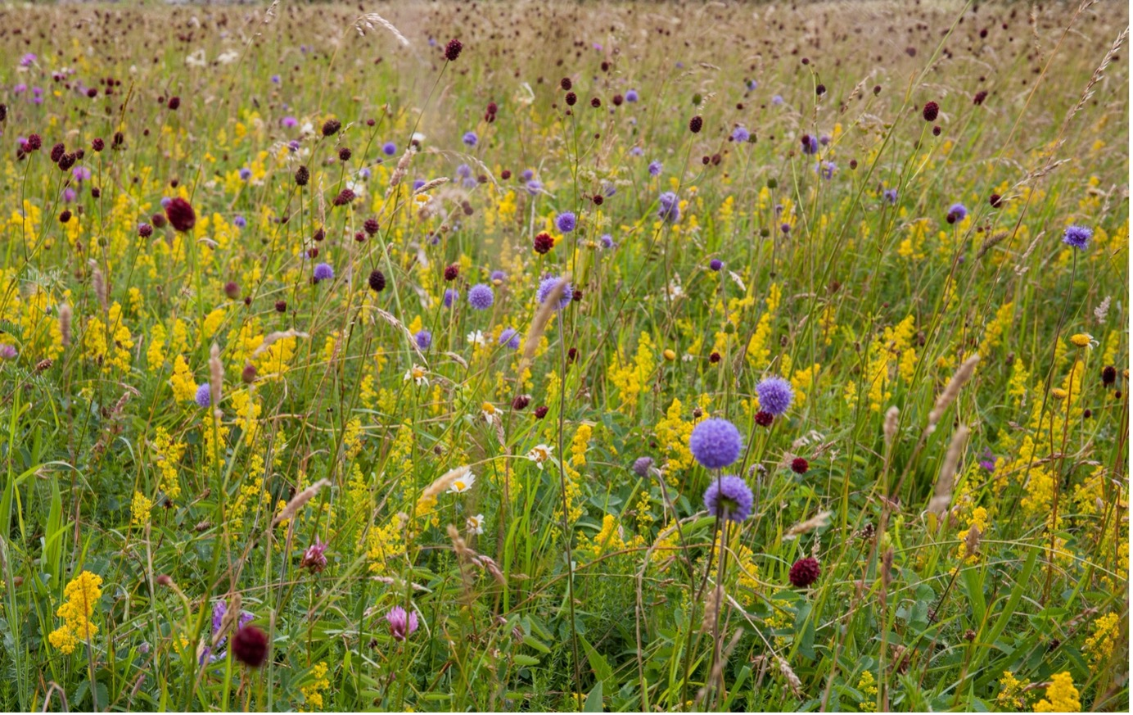
Floodplain meadows:
rare, rich and irreplaceable in our lifetime.
Prof. Kevan AC Martin,
Thames Valley Wildflower Meadow Restoration Project

Slide 10


Slide 11
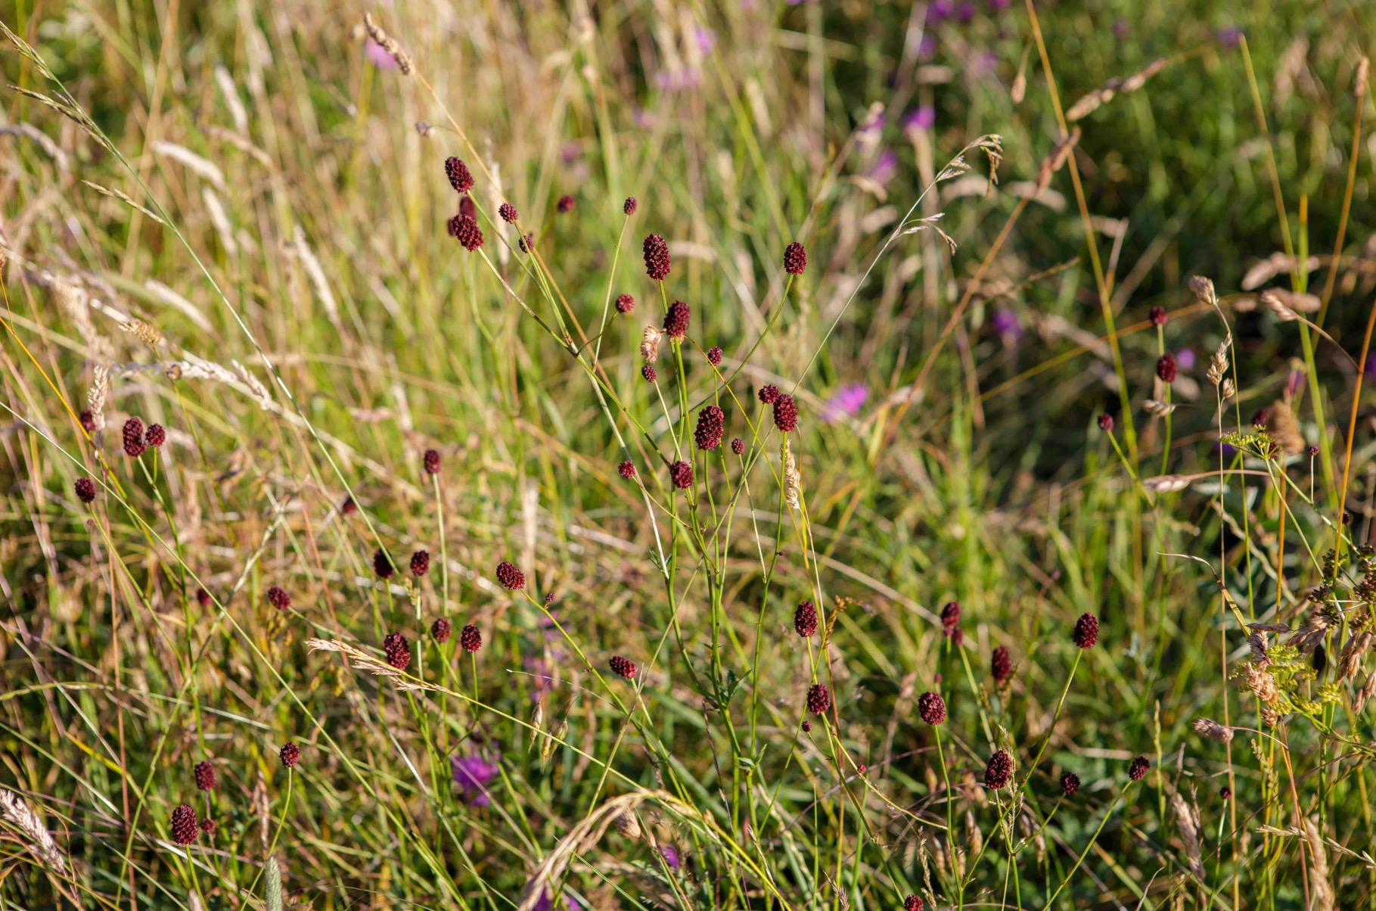

Slide 12
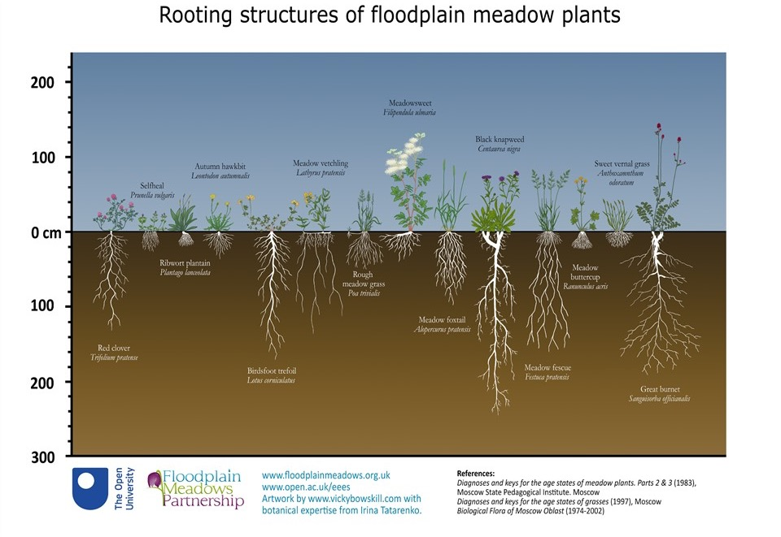

Slide 13
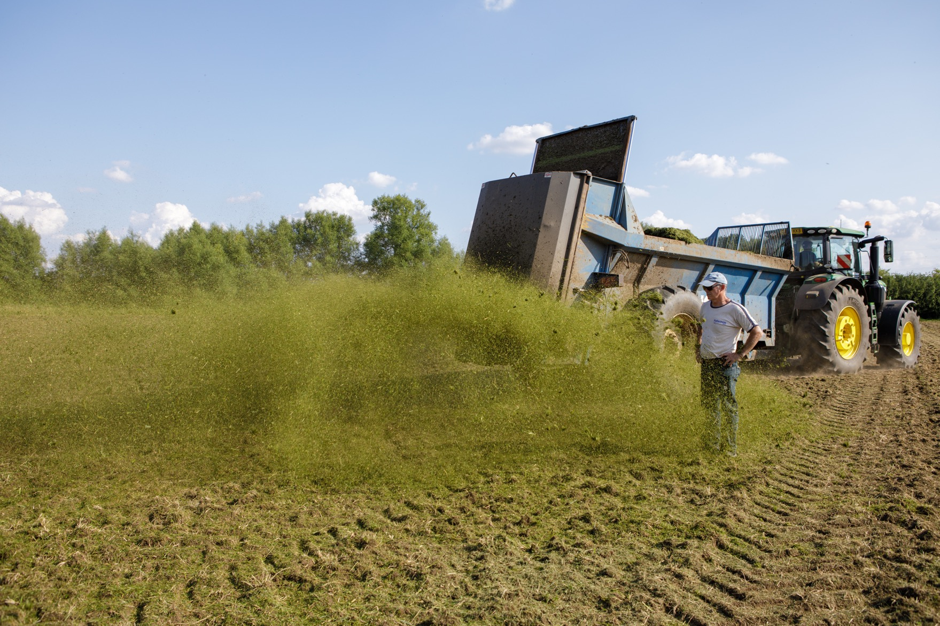

Slide 14
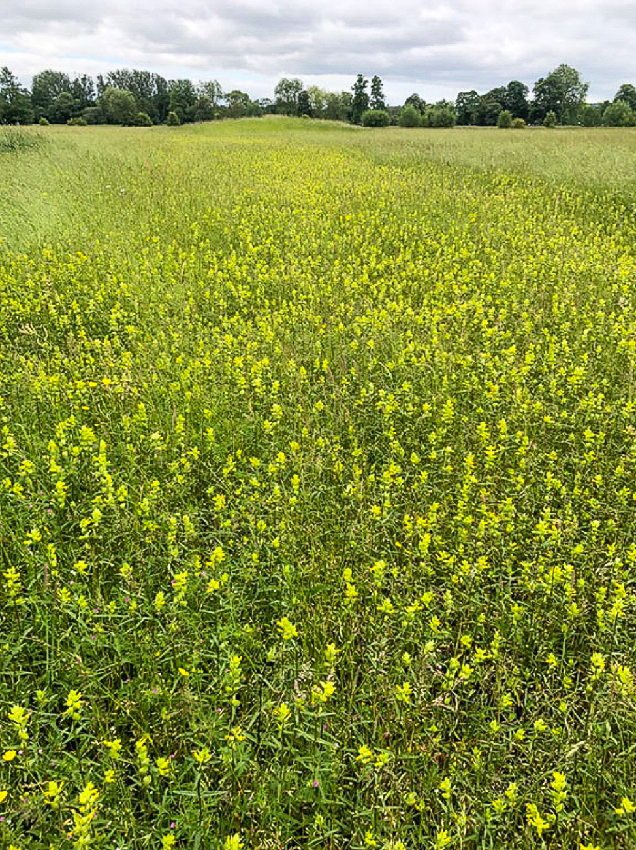
Emma Rothero, Irina Tatarenko, David Gowing,(2020)
J. Nature Conservation
Ben A. Woodcock, Alison W. McDonald. Richard F. Pywell (2011)
J. Applied Ecology

Slide 15
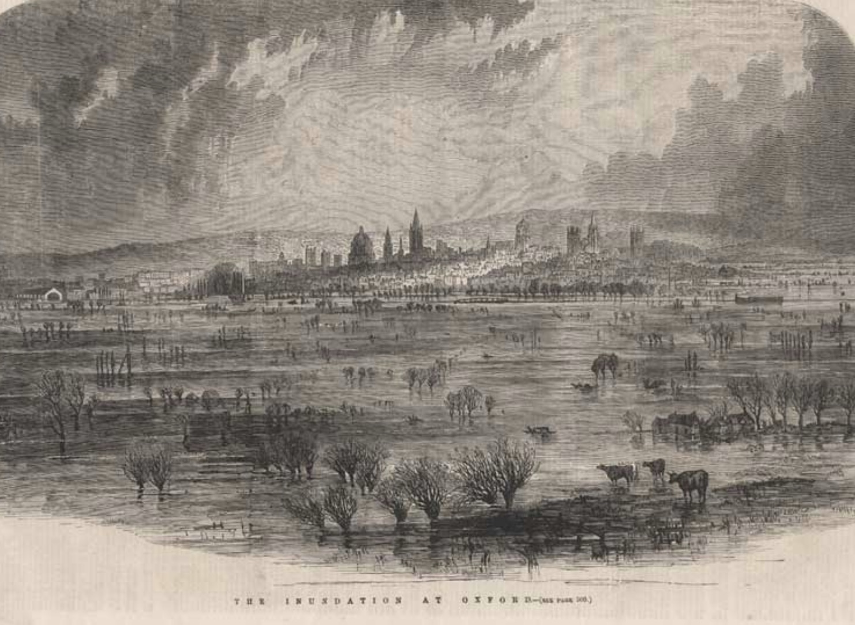

Slide 16
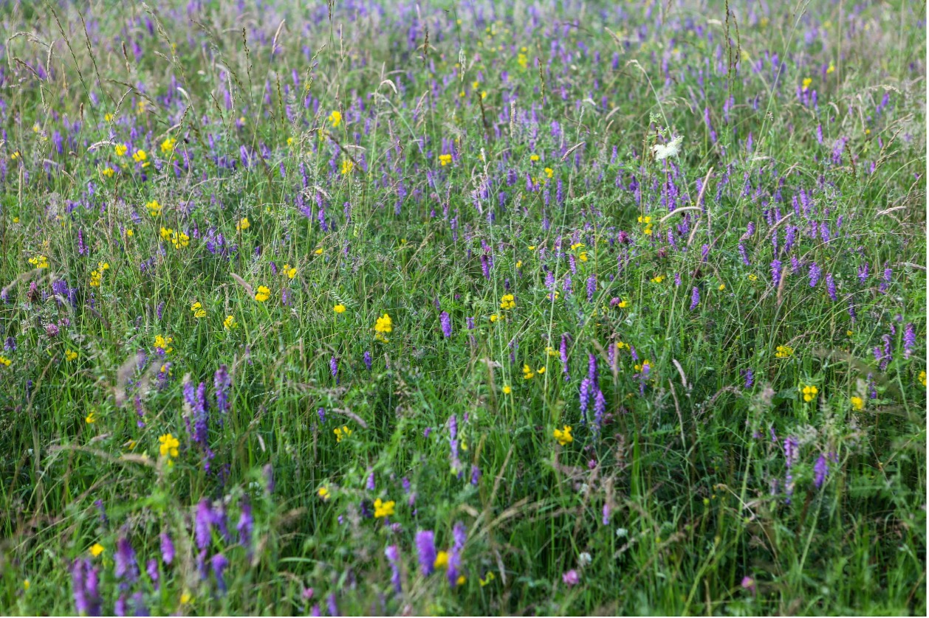

Slide 17
Further Environmental Damage
and its ‘Mitigation’
Jocelyn Wogan-Browne, Professor Emerita,
Osney Island resident, Oxford Flood and Environment Group member

Slide 18
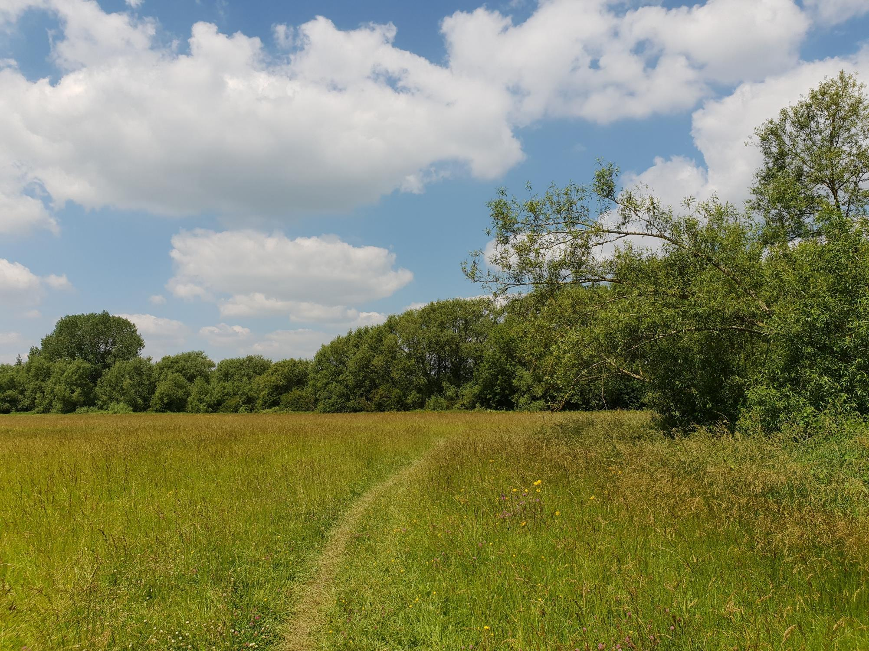
Hedgerows, mature tree copses and grasslands in the fields south of Hinksey Meadow
(97% of British meadows have been lost since WW2 and we are the most de-afforested country in Europe)

Slide 19
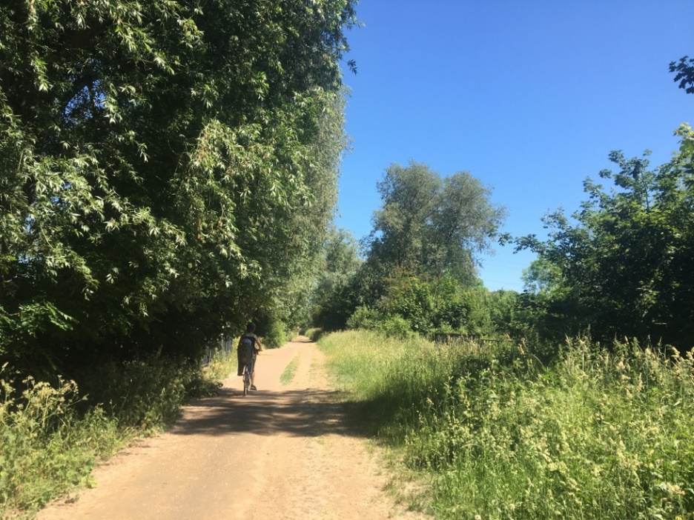
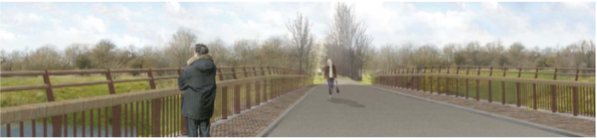
This
becomes
this
Willow Walk

Slide 20
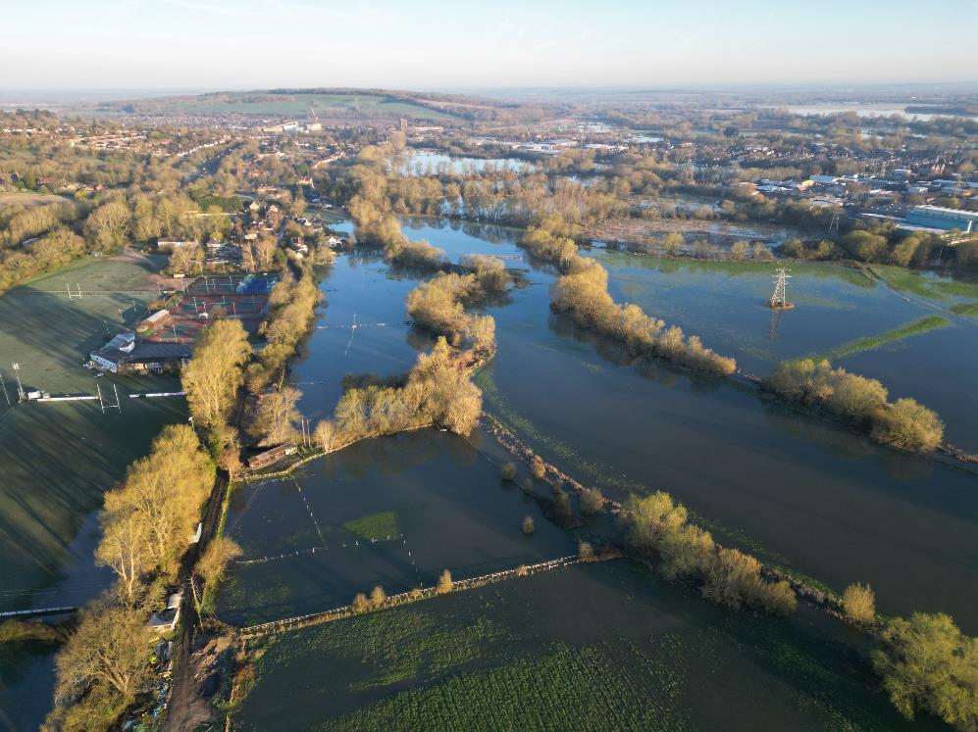
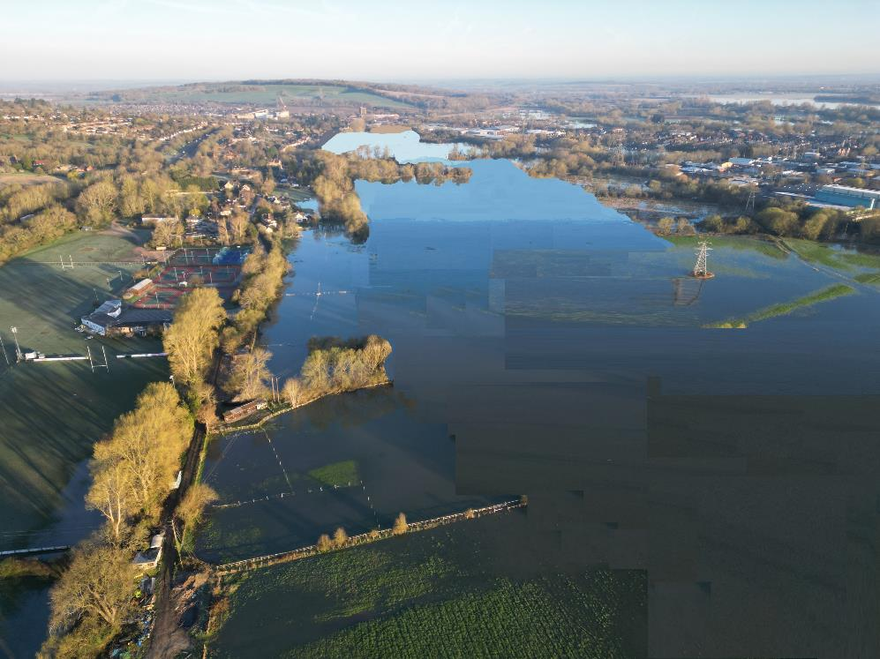
Environmental degradation
BEFORE OFAS
AFTER OFAS
Drone photo 4th April 2023
(James Wynne)
Showing loss of ~1000 mature trees
(entire scheme entails felling 4000 trees)

Slide 21
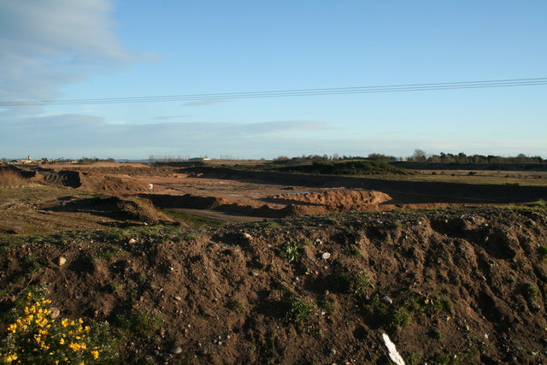
The channel runs from Seacourt Nature Park to the Old Abingdon Rd at Kennington- 5 kms long in its full extent and up to 250 yards wide.

Slide 22
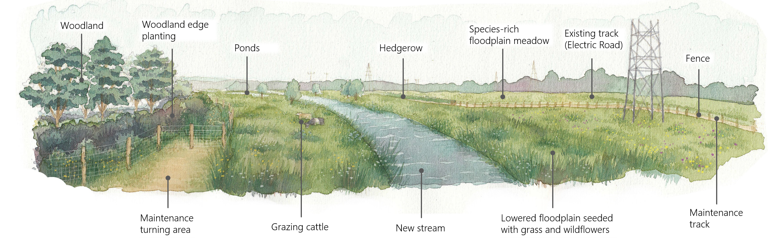
Source: EA website (initially published without reference to growth time frame: corrected under pressure from public comments)

Slide 23
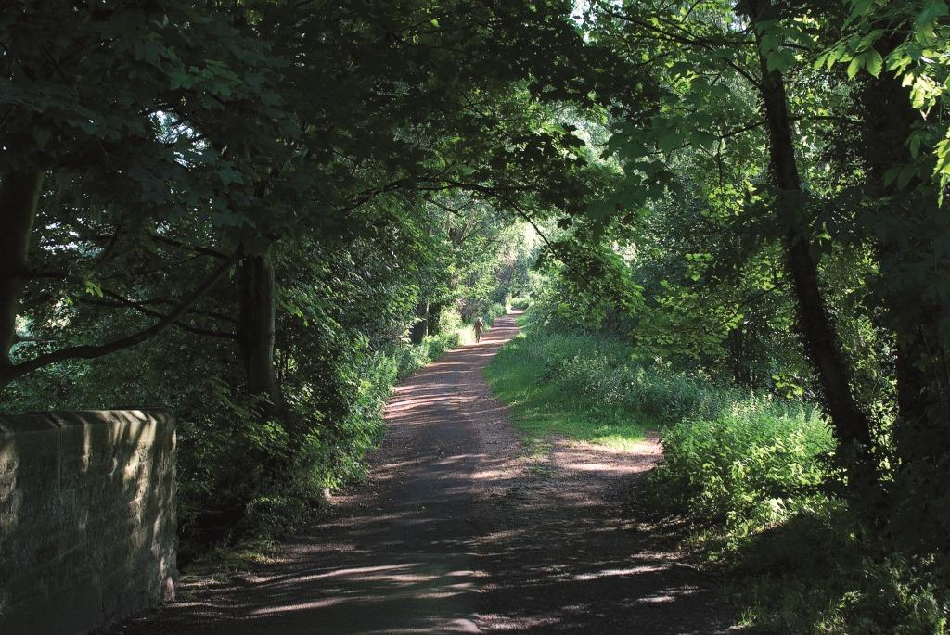
Willow Walk in
late summer now
And in future?

Slide 24
Social Costs
Dr Rod Chalk, University of Oxford

Slide 25

Financial cost £176M
(up from £111M in 2017)
Social cost?
OXFORD FLOOD ALLEVIATION SCHEME

Slide 26
Social costs:
Loss of access to green space – welfare and amenity*
Inconvenience
Loss of wildlife*
Loss of flood meadow, trees, hedgerows and natural streams*
Dust/noise/pollution
Traffic congestion (A34)
Environmental degradation*
*Costs are substantial, permanent and borne by the entire community
They are NOT factored into the cost-benefit model

Slide 27
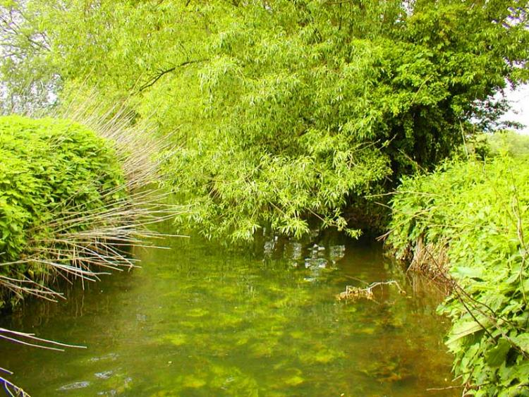
Positive effects of nature on mental health*
improve your mood
reduce feelings of stress or anger
help you take time out and feel more relaxed
improve your physical health
improve your confidence and self-esteem
help you be more active
help you meet and get to know new people
connect you to your local community
reduce loneliness
help you feel more connected to nature
provide peer support
*according to MIND, mentalhealth.org.uk, BUPA & RSPB

Slide 28
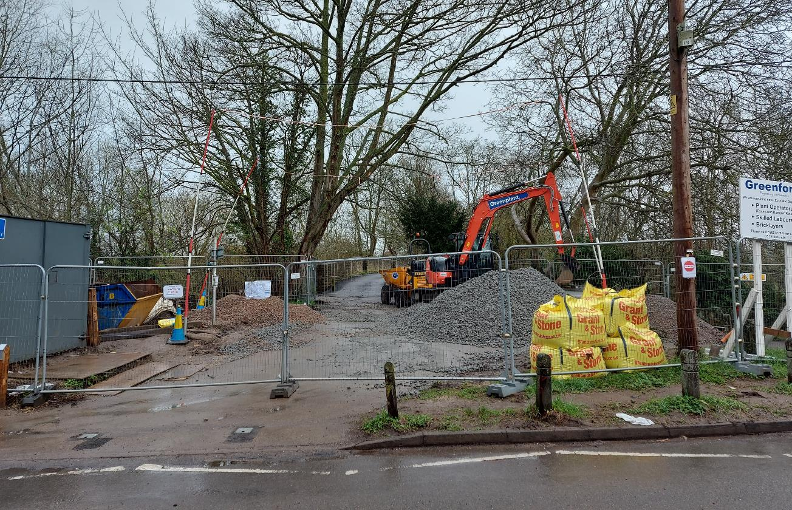
Temporary loss of access
Willow walk has been closed for 3 months forcing a 2-mile diversion on a busy trunk road for pedestrian and cyclists and causing massive inconvenience for commuters local residents and school children
Access to the flood plain will (now) be severely restricted for 5 years

Slide 29
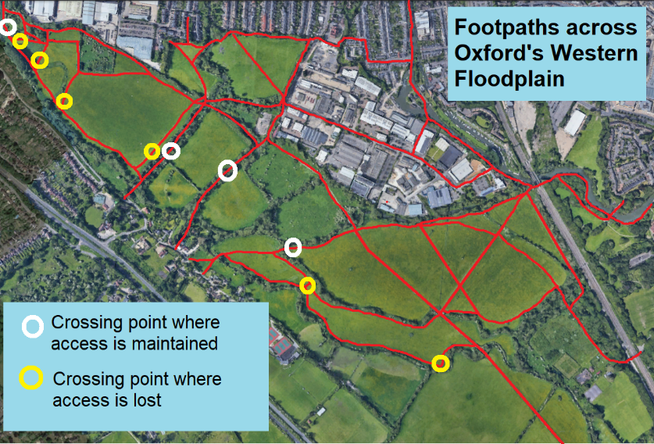
Permanent loss of access

Slide 30
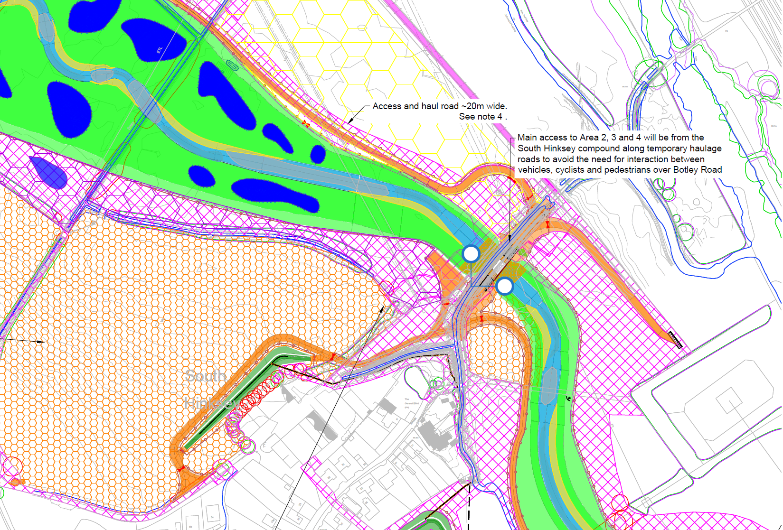
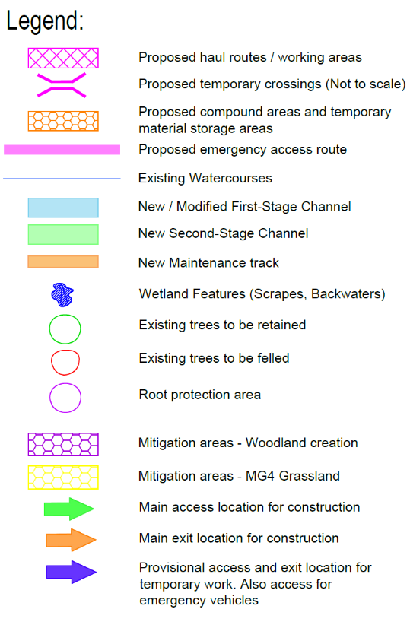
Pity the residents of South Hinksey
Access haulage road 20m wide (2 bus lengths)
Haulage Road
Works compound and material storage
Works compound and material storage
Haulage Road
Trees felled
South
Hinksey
Village
Haulage Road
Haulage Road

Slide 31
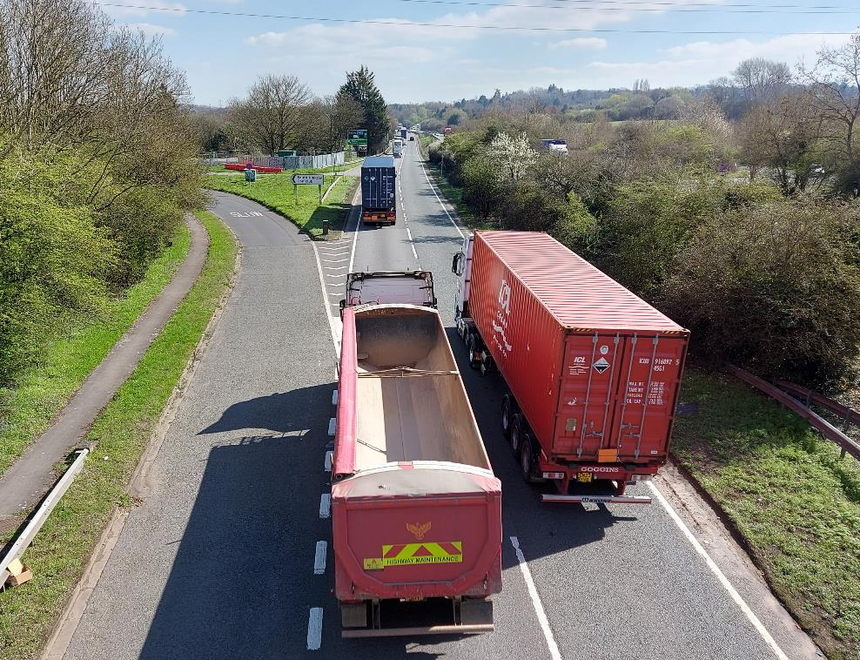
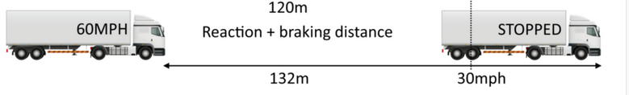
A34 national trunk road at South Hinksey
Inadequate South Hinksey slip road is just 90m
111 HGV movements/day at this junction
40 mph speed restriction must be applied
A34 is frequently at a standstill under normal circumstances
Delays will spill on to ring road & M40
Disruption in addition to the massive disruption already planned by the closure of Botley Rd

Slide 32
HOEG
Pumped Pipeline
Seacourt
to
A423 Bypass
East side of Railway
Kevin Larkin (Architect)
Jonathan Madden

Slide 33
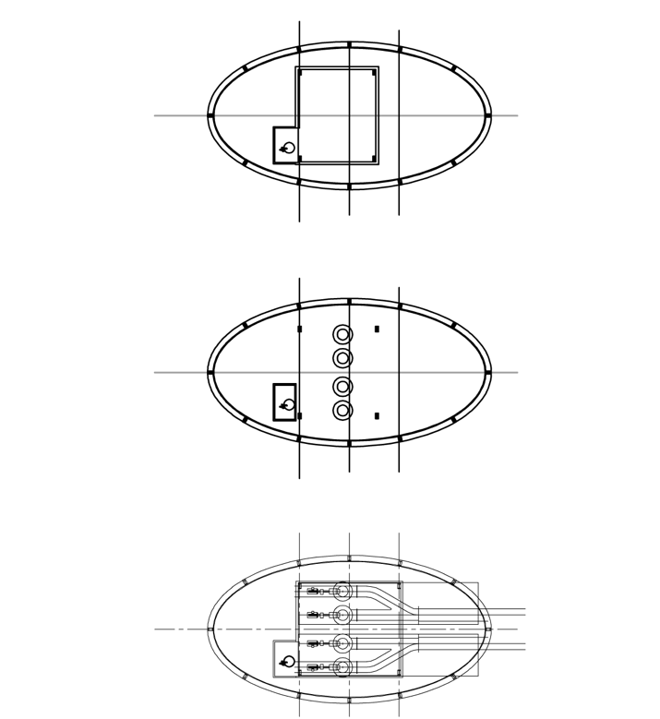
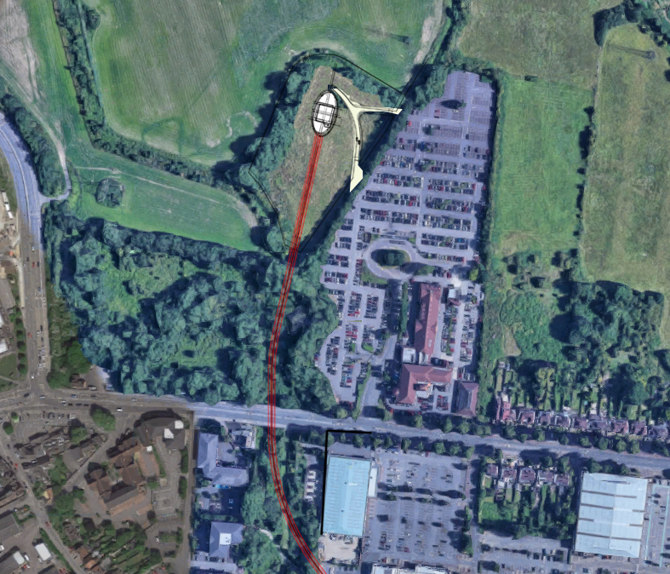
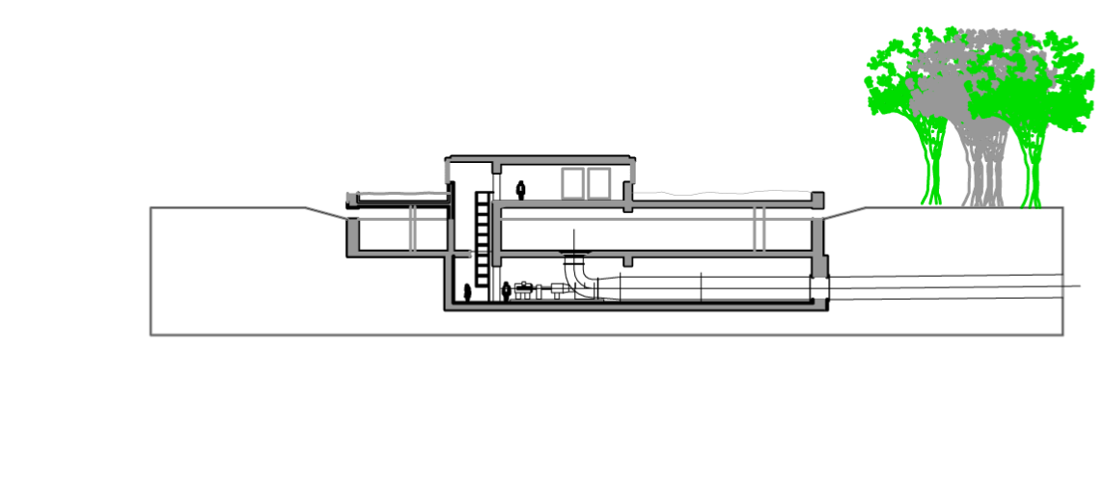
Top: Utilities – diesel electric standby generator; switch gear; fuel tanks.
Spillway diameter: 100m
Major axis: 40m
Minor axis: 20m
Pylon anchors with ‘H’ girders reinforce concrete surround and spillway.
ii) Penstock level: flood water intake into axial flow pumps.
iii) Axial flow pump room. Sub-ground level. Four pump output converged into two pipes.
Grassed area surrounding utilities housing
Triple level plan and profile drawings of pump house.
Vehicular access to pump house from car park.
Flood level
Outlet of 2 x 2m diameter GRP pipes, on shallow gradient to ca. 2.5m depth.
Profile of spillway into penstock and pumping system. Spillway protected with grilles to control debris ingress.

Slide 34
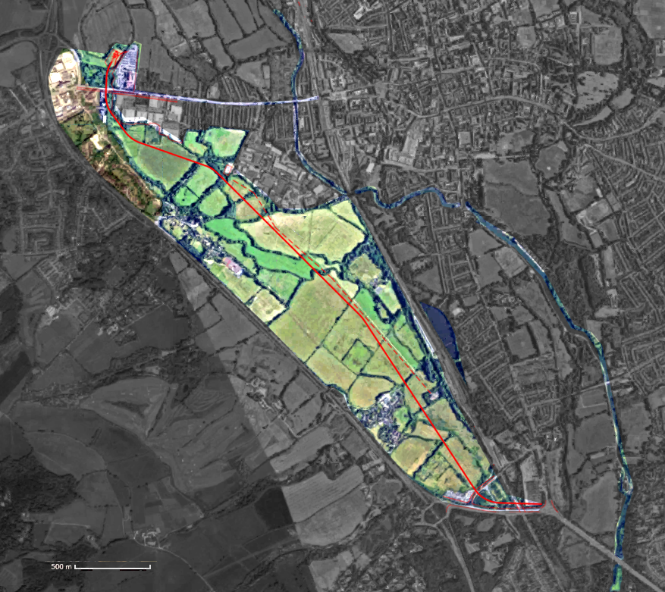
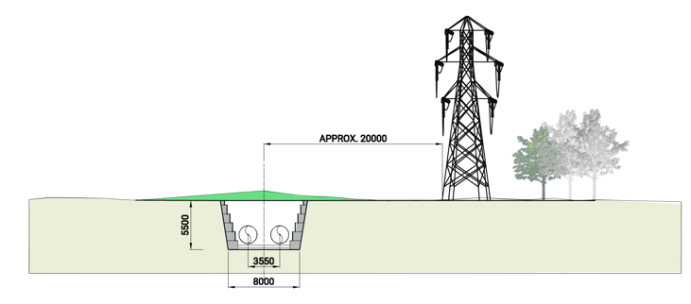
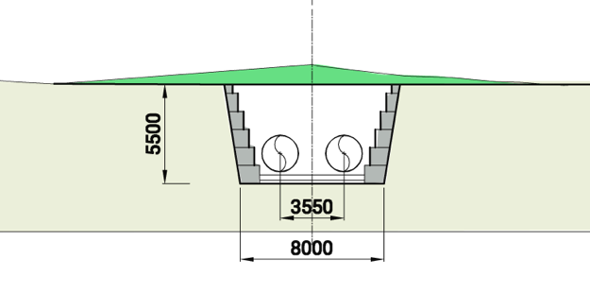
X-sections showing buried pipeline in trench to scale parallel to the Electric Road. (Measurements in mm)

Slide 35
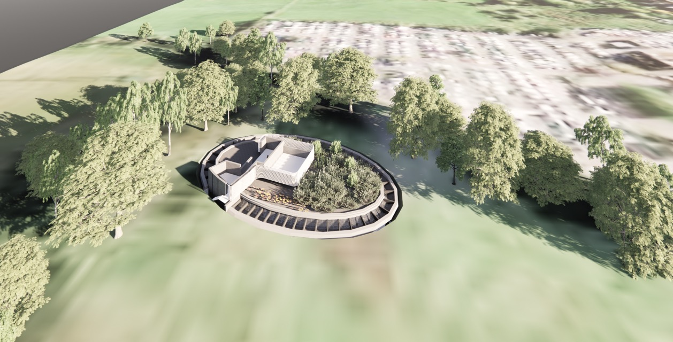
Plan view of Pumping Station, adjacent to Seacourt Stream

Slide 36
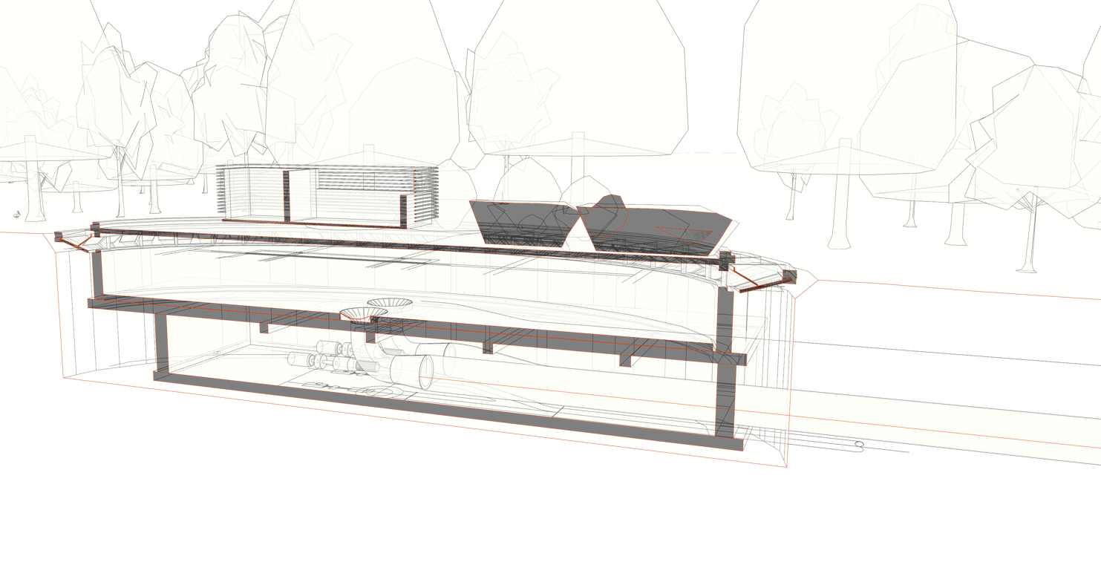
Section through Pumping Station, illustrating Axial Flow pumps and three-level design

Slide 37
Advantages of Pumped Pipeline System
  Uses well understood techniques and designs, common for water management and fluid transport in general
  Moves water volumes equivalent to and greater than OFAS channel. Design is for 44cumets/sec.
  Pumping can begin at an early stage of flooding, thereby ‘flattening’ the water level curve. Lowest level of inlet spillway connects to Seacourt Stream at 56m AOD.
  Cost-efficient in terms of equipment and civil engineering
  Very low volume of spoil removal off-site reduces heavy vehicle movements on local and main roads
  Reinstatement of existing landscape eliminates need for annual maintenance costs

Slide 38
Pumped Scheme: Approximate Costings:
Hinksey and Osney Environment Group
Pumped Pipeline Alternative Proposal: Outline Costings
 | Item: |  |  |  | Cost: (£1,000) |  | Notes:
i) | GRP Pipe Sections: 5km, 2m diameter. Twin Pipes |  |  |  | £2,000 |  | Future Pipe Industries: Pipe Sections, delivered as telescoped sections of increasing diameter
ii) | Four x Ensival Moret 1.5m dia. Axial Flow Pumps |  |  |  | £2,000 |  | Low pressure head, high volume. With cycloconverter high-torque start system.
iii) | Steel 'Y' manifolds from pump outlets to main 2m pipes |  |  |  | £250 |  | Steel ‘Y’ manifolds, bringing output from four pumps into two, 2m dia. pipes. Equipped with valves to permit flexible operation with fewer than four pumps.
iii) | 2MW Standby Backup Diesel Generator and switchgear |  |  |  | £400 |  | Reconditioned, used unit. Switchgear for transfer from grid in case of outage. Located over pump room, above flood level.
iv) | Pump House |  |  |  | £2,500 |  | ‘Swimming Pool’ concept, excavated to 10m depth.
v) | Inlet spillway |  |  |  | £750 |  | Reinforced concrete, elliptical profile, with varying OD elevation, for graded floodwater ingress.
vi) | Penstock |  |  |  | £250 |  | Epoxy screed penstock, guiding flood water into pump inlets.

Slide 39
Costings: cont’d
vii) | Pipelaying onto concrete supports |  |  | £1,500 |  | Anchoring to control float forces by flexible steel bands
viii) | Trenching, and backfill. Shallow bund construction |  |  | £4,000 |  | Est. £25/cumet, for 150,000 cumets.
ix) | Design |  |  | £1,000 |  | Detailed engineering design. Environmental and archaeological studies.
x) | Discharge Race |  |  | £200 |  | 30m reinforced concrete ramp, baffled
xi) | Landscaping |  |  | £2,000 |  | Recover landscape to previous state. Plant trees and grasses. Reinstate footbridges etc.
xii) | Electrical Connection to Mains |  |  | £250 |  | Connect to national grid
 |  |  | Total: | £17,100
 | Contingency for uncertainty in ground works, other on-site work, etc. |  |  | £5,000
 |  |  | Extended Total: (£k) | £22,100 |  | Does not include work in OAR/Railway/Bypass area.

Slide 40
How the scheme design can be improved based on the present planning consultation under Regulation 25
Brian Durham
New Hinksey Resident
Archaeologist to Oxford City Council (retired)
In August last year the planning authority requested that the application be `supplemented with additional information which is directly relevant to reaching a reasonable conclusion’.
The applicant (Environment Agency) has responded.
Notes:
Tim has assessed the value for money in terms of property protected, Kevan and Jocelyn have assessed he ecological impact, and Rod has assessed the landscape and human impacts. Re- Alternatives, Jonathan has outlined an innovative design that would resolve all the above.
From outside this group, an ecologist Tim King in 2019 proposed two conventional alternatives, one of which - `no excavation’ - has been addressed by the applicant (Environment Agency) which they call Option A2.
In August last year HOEG asked for more information on a string of issue under the`Regulation 25’ stage of the application, and my contribution outlines what if anything has come back, how informative it is, and compares it with a candid response to similar requests from a professional peer reviewer commissioned by Oxfordshire County Council.

Slide 41
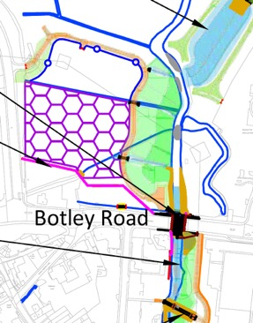
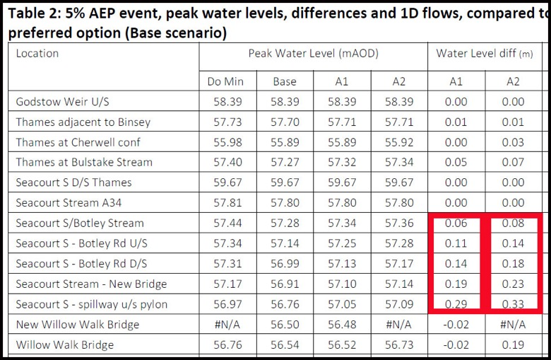
Reg 25 para 5.2 Channel improvements on Seacourt Stream please provide confirmation these have been applied to Scenario A2
The applicant has provided the `confirmation’, but in doing so has made no effort to explain the extreme difference values at the four nodes in question (red boxes).
These values would make the alternatives A1 and A2 appear to perform worse for Botley Road and Osney.
The communities need the Peer Reviewer to examine the source of these extreme values.
Notes:
We start from upstream end of the Scheme.
My first three slides relate to the even-handedness with which the applicant balances `no-excavation’ against their preferred option.
Here we highlighted five modelling nodes (red boxes) where the alternatives perform dramatically worse than the preferred option, water levels up to 33cm higher, which will have big property impacts, but the Regulation 25 response gives no hint at to why this is happening.
This is a section of the flow path with no environmental concerns.
One for the Peer Reviewer.

Slide 42
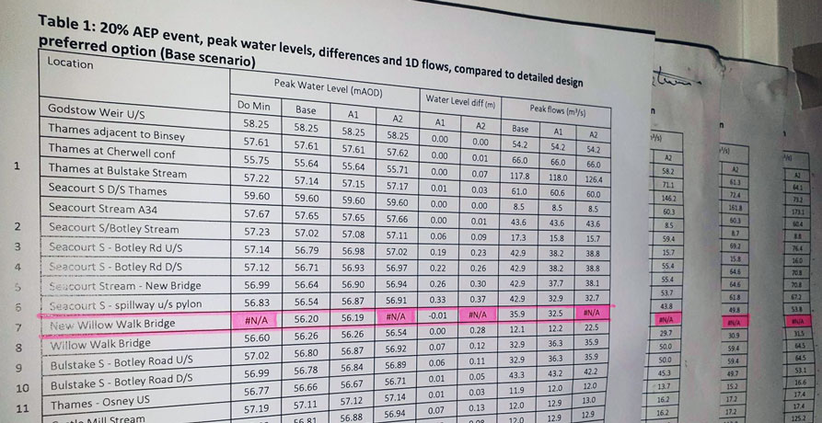
Reg 25 para 5.1 Willow Walk New Bridge #N/A values please provide the missing water levels or full explanation
The applicant has ignored the request for missing levels at what is ecologically the most sensitive location next to MG4 grassland.
The communities need the Peer Reviewer to ask why the engineers were not able manually to infill these gaps in their model output?
Notes:
At Willow Walk New Bridge we asked why we get #N/A in so many boxes at all the flood return periods.
Being ecologically the most sensitive of the forty-something nodes, we assumed that the applicant could manually add real values, and we need the Peer Reviewer to ask why this was not done.

Slide 43
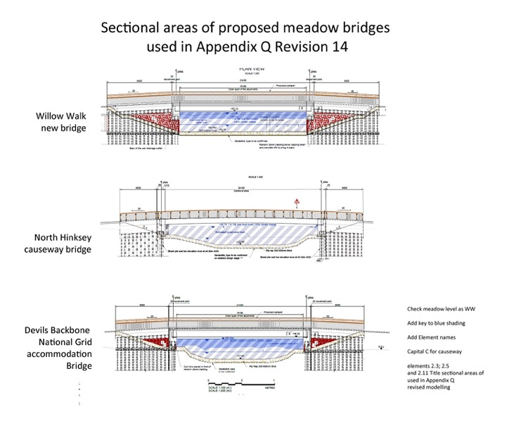
Reg 25 para 5.3 Please provide the reason for not applying locally-lowered beds in modelling proposed bridges
The applicant responds - In the no-channel scenarios the bed level at these locations is set at the surrounding field levels as localised lowering will provide no hydraulic benefit and will silt up to the surrounding field levels over time
We need the Peer Reviewer to remind the applicant that:
  they used `lowered beds’ themselves in the 2018 scheme
  They are here predicting what the model will do, when they were not prepared to do that at Willow Walk New Bridge (above)
And to ask how this exercise helps compare the performance of alternatives?
Notes:
For reasons stated here, we think the model could have been told that the no-excavation option would have locally-lowered beds under these three proposed bridges, otherwise the comparison process seems invalid.
Incidentally, in the section of meadowland channel where there are no bridges (blocked or otherwise) the no-excavation option performs as well or better than the preferred option.

Slide 44
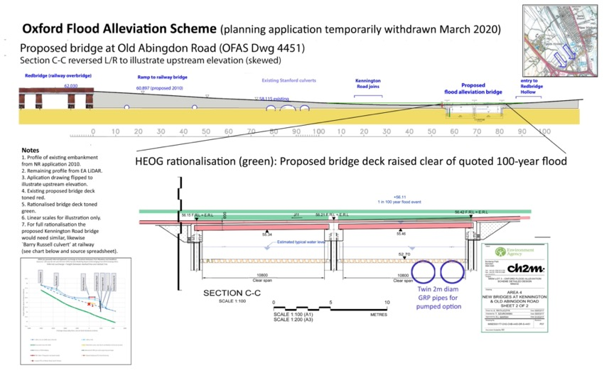
Reg 25 para 5.10.2 Need for single-bridge design at Old Abingdon Road
On 16 February 2021 the applicant’s consulting engineer described the single offline bridge option as a `more elegant solution’, and HOEG asked to see County Highways view of this option.
The communities can reasonably ask for that response to be made available in the planning process
Biggest flow obstruction in Scheme,
backs up water into South Hinksey and New Hinksey.
Proposed bridging starts to obstruct flood water in a 2-year return period.
Avoidable by raising the proposed decks less that 1m (shown green) to let the flood flow through.
Even better, a single new bridge constructed on open ground saves three years in construction
Proposed bridging at Old Abingdon Road (red) and
flood-friendly, traffic-friendly alternative (green)
Notes:
We are looking here at the Old Abingdon Road from upstream, a manmade blockage to floodwater. The `Stonehenge’ structure is the railway at Redbridge.
The bridge-deck shown Red is as proposed, and starts to block flows from a 2-year return period,
The bridge-deck shown Green illustrates the very limited additional height for a 100-year flow to pass under it, and incidentally to give more depth for service runs.
Here HOEG will be asking for a statement from County Highways to be included in the planning application.

Slide 45
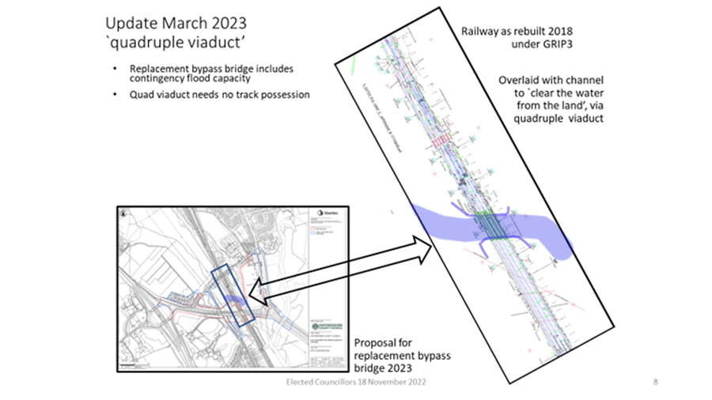
Reg 25 para 5.10.3 Need for protection of the railway at Kendall Copse East
The Scheme directs flood water towards a 550m-long stretch of railway line.
This is relevant because:
  National rail infrastructure
  Oxford’s economy depends on railway servicing of the BMW Mini Plant
  Oxford will use this line for passenger service to Cowley Station;
The alternative is to take the water under the railway (image opposite). A viaduct can logically be constructed one track at a time because of an extra track.
The communities can reasonably ask for the planning process to include a statement from a Network Rail chartered engineer that the present design has no avoidable risk for the railway.
Notes:
At the downstream end of the Scheme there is a second man-made blockage to flood water, the railway embankment, which suffered a `washout’ within eight years of construction (1852 Illustrated London News).
We have seen a transcript of a conversation between EA and Network Rail in which both sides seem to have learnt home truths.
But nothing changed to take the flood pressure off the railway and off residential Kennington!

Slide 46
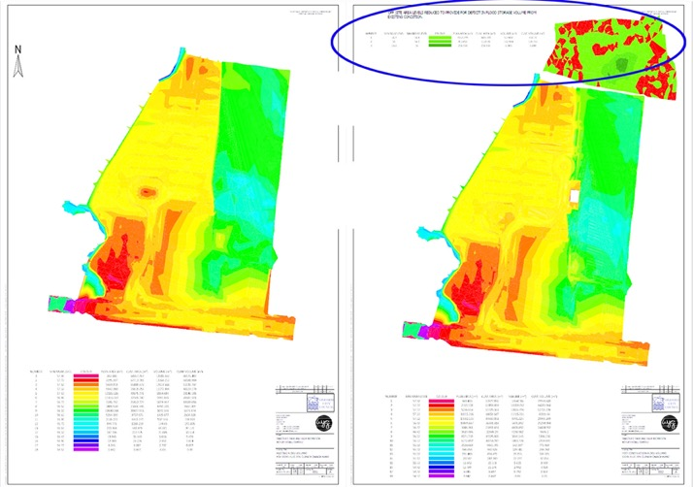
Reg 25 para 5.10.4 Need for formal floodplain compensation analysis
Scheme has not provided a floodplain compensation analysis (FCA). For example:
At New Hinksey the scheme is putting an earth bank round 10 hectares of floodplain, sacrificing 100,000 cubic metres of flood storage.
Without this, the east floodplain would gain an extra 5% alleviation effect.
Function of bank could be achieved with a low masonry wall along Abingdon Road back of footway
The communities can reasonably ask for the Peer Reviewer to assess the extent to which this embanking degrades performance of the scheme
Floodplain compensation analysis provided by City Council for Seacourt Park and Ride extension
Notes:
In a light-bulb moment it has become apparent that what the applicant calls `volumetric floodplain compensation’ may be using some of the alleviation benefit of the scheme to compensate for avoidable obstructions created by the scheme, a process of dumbing down its performance.
The Peer Reviewer might assess if we are right to ask for an FCA.

Slide 47
Reg 25 para 6.2 Please simulate a higher resolution or multi-domain set up
Modelling domains
The Environment Agency is on record that the proposed meadowland channel design has never been tried on this scale.
The communities can reasonably ask for the Peer Reviewer to assess whether the applicant’s response on their modelling (opposite) justifies the experimental design of the meadowland channels, given the scale of ecological and landscape damage we have heard.
Applicant’s response to peer review
`Based on the hardware available at the time [2018] the run times for 2D grids smaller than 10m were prohibitive.
…. attempts [to reduce run time on a GPI machine] were unsuccessful and resulted in unreliable performance of the model.
Considerable time was spent unsuccessfully trying to determine the reasons for this, including discussions with the TUFLOW support service.’
Notes:
The applicant’s response seems to say the`unreliable’ model and `unsuccessful’ attempts to resolve it are unavoidable.
But given the wider downsides listed by Tim, Kevan, Jocelyn and Rod, and uncertainty about the process of comparison with the `no-excavation’ alternative, maybe the answer is instead a conventional flood scheme design as outlined by a previous reviewer David Ramsbottom (Hydraulics Research Wallingford).
The planners may need guidance from their own Peer Reviewer.

Slide 48
Is this good enough to expect our cooperation?
Given the evidence of under-resourced and `unsuccessful‘ modelling, HOEG has forewarned Oxfordshire County Council’s flood officer of gaps in the Regulation 25 responses.
The communities can reasonably ask for the Peer Reviewer to provide a expert opinion on: the even-handedness of the comparison process; the reliability of the modelling; and any degrading of floodplain storage, also written statements from County Highways and Network Rail on the remainder.
HOEG has drafted such a letter that will go out before the deadline of midnight tonight, adding any thoughts from this meeting, thereby formally alerting the planning authority to expect further comment from yourselves.
Notes:
The slide speaks for itself. I have here the draft letter that will go out by midnight. It is also on my old laptop here in case any member of this audience wants to endorse it, or we can have a show of hands later.
Thanks for your attention, I now hand over to Patricia to sum up.

Slide 49
NEXT STEPS
How to comment
Patricia Murphy, author and TV Producer/Director,
Oxford Flood and Environment Group

Slide 50
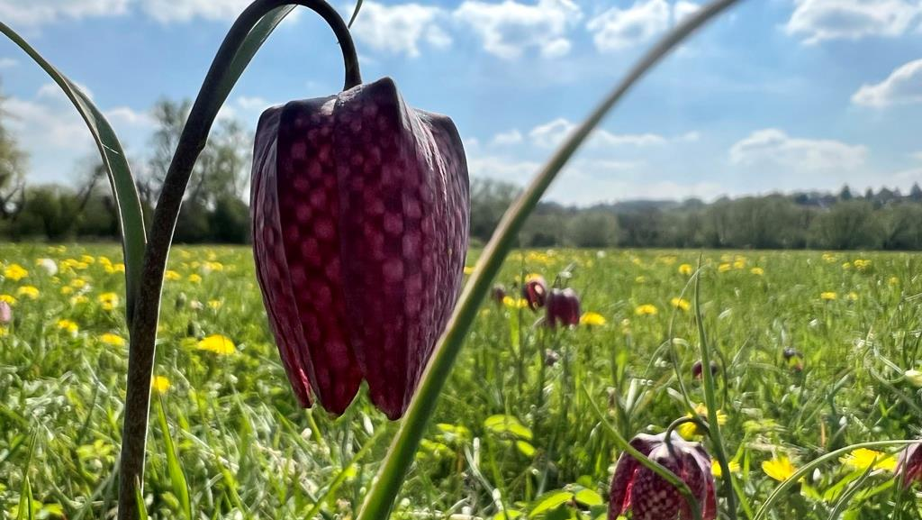
Next Steps
How to comment

Slide 51
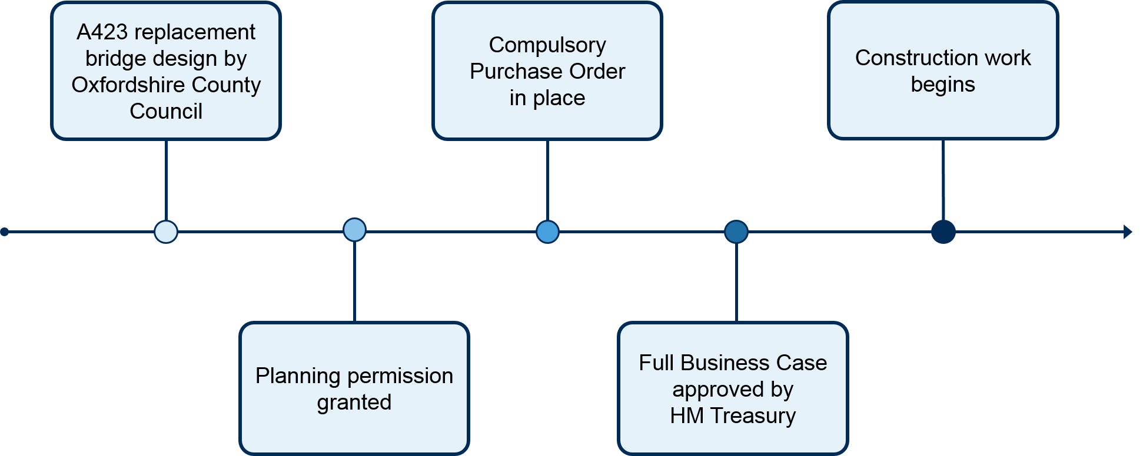
The planning process

Slide 52
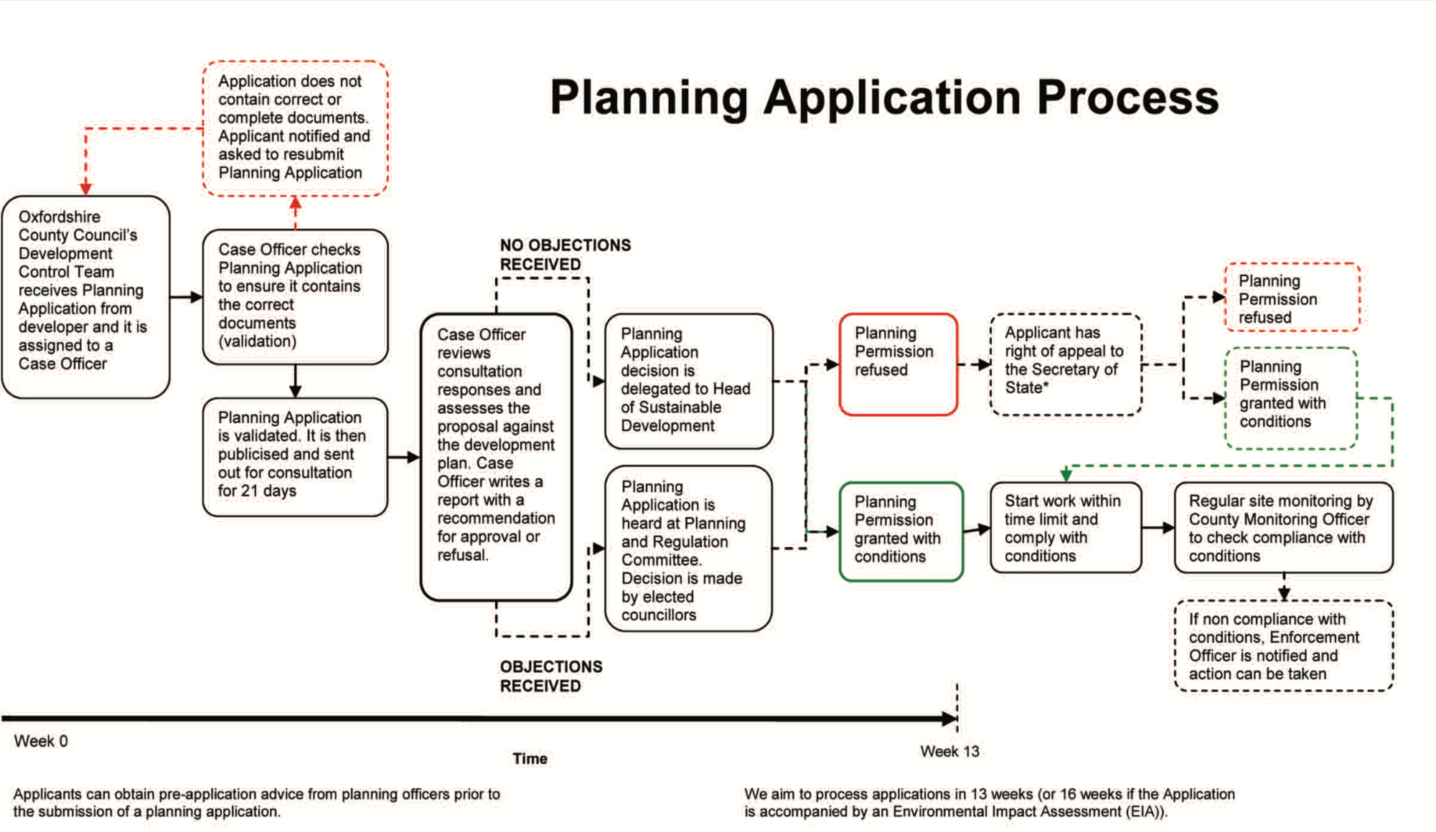

WE ARE HERE
WHAT YOU CAN DO

Slide 53

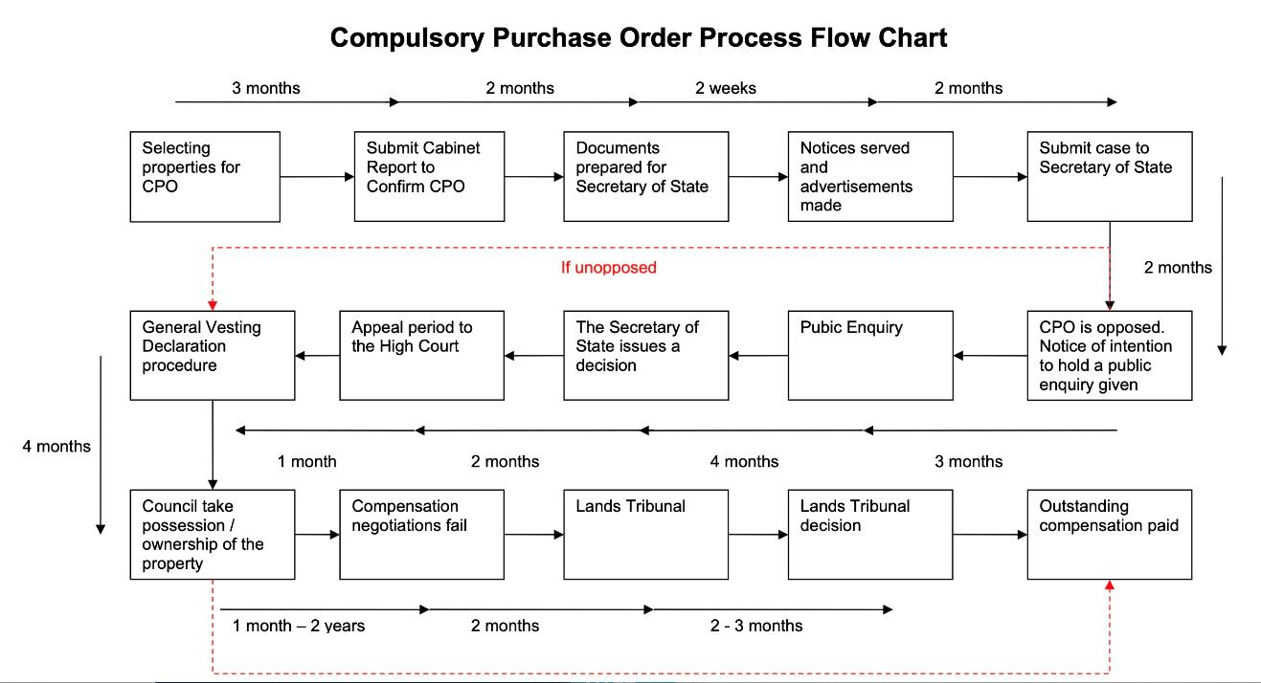
Compulsory Order Process -

Slide 54

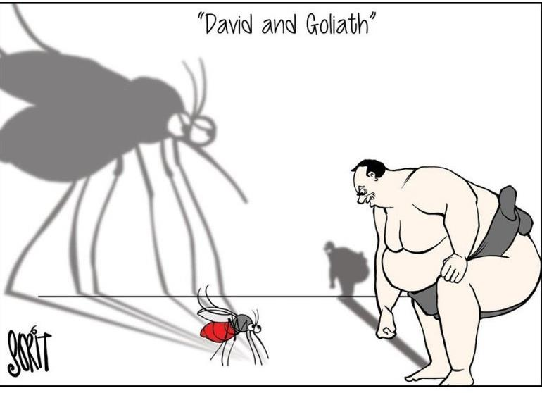

Making our voices heard the power of numbers

Slide 55

Effective Comments and Objections
State clearly whether you support 85% of the measures but want the Channel from Botley Rd to Old Abingdon Road scrapped
DO NOT COPY AND PASTE!
Just a few lines is acceptable
You can say you support the questions raised by HOEG and OFEG to the Regulation 25 letter.
Where you can find inspiration eg. objection on www.oxfordfloodandenvironmentgroup.com
https://hinkseyandosney.org

Slide 56

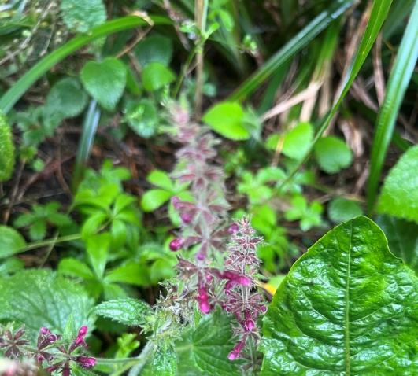
Economic, impact, errors and omissions
The EA has admitted that the flood scheme is untested on this scale, that the 2018 flow modelling was limited by available computing power, and their attempts to remedy this have been unsuccessful.
Failing to create sufficient openings in man-made obstructions – the design would create flood backup as a result of obstruction by the proposed bridge decks at old Abingdon Road and by omission of a modern viaduct at the railway in Kennington.
- Modelling errors according to independent hydrologists and engineers not addressed in recent consultation. There is no evidence that the peer reviewers understood the issues around sensitivity tests. Nor have there been tests for impact of bunds and defences.
The EA has failed to model the economic impact or have a fair comparison process of not having a channel. Despite the fact that the channel provides under 3% of benefits to just 25 extra properties and is the most expensive aspect of the scheme
EA need to demonstrate that the channel is not a risk to the railway and that the twin bridges design in optimal
Failure to review the safety of the lowered floodplain in the light of unsuccessful modelling by applicant
democratic deficit - inadequate public consultation
Waste of money and resources that could be used for a better flood scheme
Better Alternatives Available not properly considered – eg pump
Unacceptable impacts on traffic on the A34, including a 40mph speed restriction
uncertainty about the effectiveness of a temporary bridge at Kennington

Slide 57
HOEG will be asking the planning authority for:
OCC Peer Reviewer to report on whether the comparison process with the no channel excavation option proposed by Dr Tim King has been even-handed.
To review on any impact from the avoidable removal of 10ha from the east flood plain on the effectiveness of the flood alleviation.
To review the safety of the experimental channel in the light of the `unsuccessful’ modelling reported by the applicant.
Network Rail chartered engineer to confirm in writing that, in the light of the existence of an additional track, the 0.36m water level difference presented no risk to the railway.
OCC Highways to confirm in writing that the twin bridges design is optimal compared to a single line bridge “elegant solution” proposed by Jacobs engineers.

Slide 58

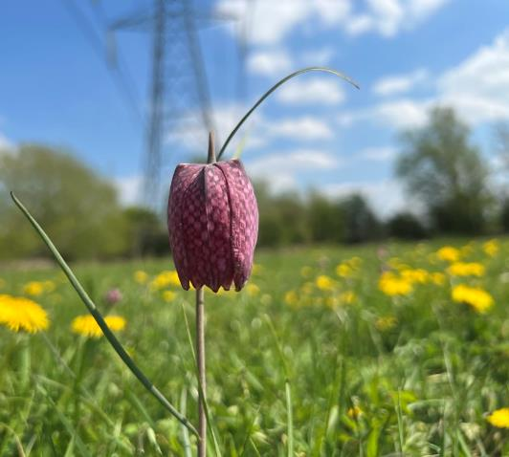
Objections – Environmental
Biodiversity loss – a minus 1% loss of over 2,000 trees and miles of hedgerow with mitigation offsite not yet secured.
- Loss of irreplaceable Hinksey Meadow and Kennington Pit Local Wildlife
- Loss of access for at least 5 years and loss of public land long-term
- Assault on greenbelt – loss of 133 acres and 250 acres of farmland. Breaks several National Planning and Policy Framework directives and fails to demonstrate “exceptional circumstances in light of new requirements about protecting green belt.
Not future proof – will not keep up with climate change
Harm to people’s health, particularly in South Hinksey, from pollution, noise, vibration, dust and air
does not follow the ‘mitigation hierarchy’ of first avoiding impacts (e.g. no channel through Hinksey Meadow), then mitigating (narrower channel) and then compensating (trying to create new sites).
A ‘no channel’ option would avoid most of the OFAS impacts.

Slide 59
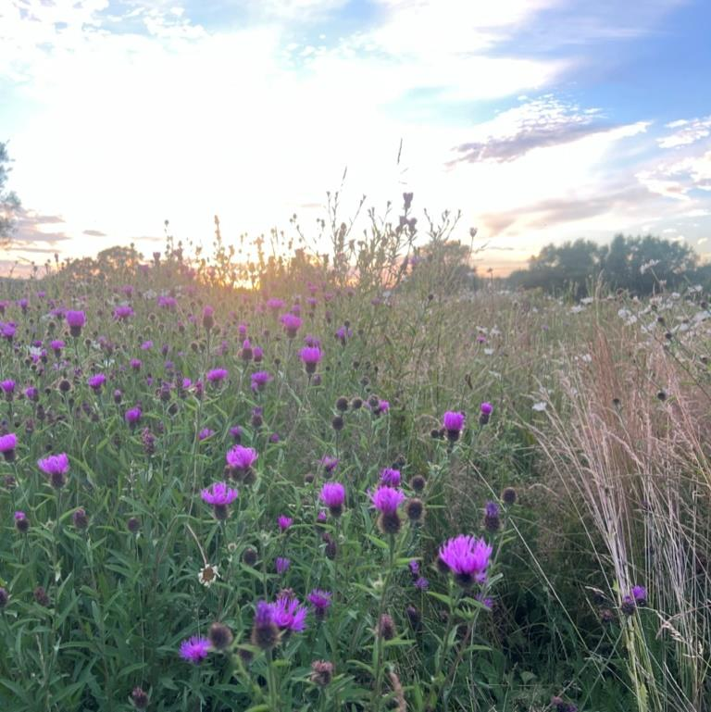
INFORMATION SOURCES
https://hinkseyandosney.org
https://www.oxfordfloodandenvironmentgroup.com
https://consult.environment-agency.gov.uk/thames/oxfordscheme/
https://www.onlyoneoxford.org/save-hinksey-meadow
Insta – Hinksey_Meadows
https://www.facebook.com/profile.php?id=100090583792185

Slide 60
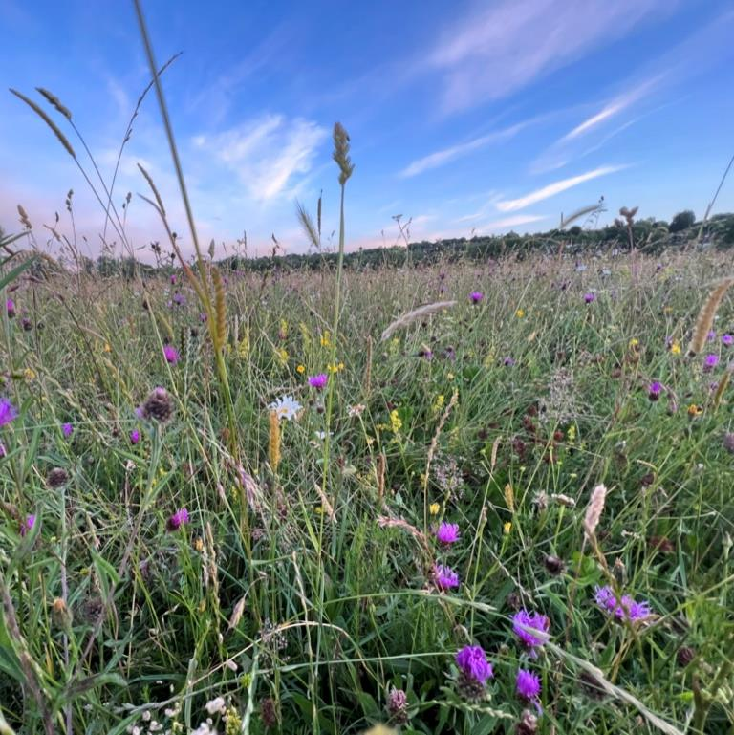
How To Comment
Matthew.Case@Oxfordshire.gov.uk
https://myeplanning.oxfordshire.gov.uk/Planning/Display/MW.0027/22#undefined
MP layla.moran.mp@parliament.uk
anneliese.dodds.casework@parliament.uk
Councillors https://mycouncil.oxfordshire.gov.uk/mgMemberIndex.aspx?VW=TABLE&PIC=1&bcr=1
https://mycouncil.oxford.gov.uk/mgCommitteeMailingList.aspx?ID=0
Petition https://www.change.org/SaveHinkseyMeadow
Therese Coffey if you support a public inquiry therese.coffey.mp@parliament.uk

Slide 61
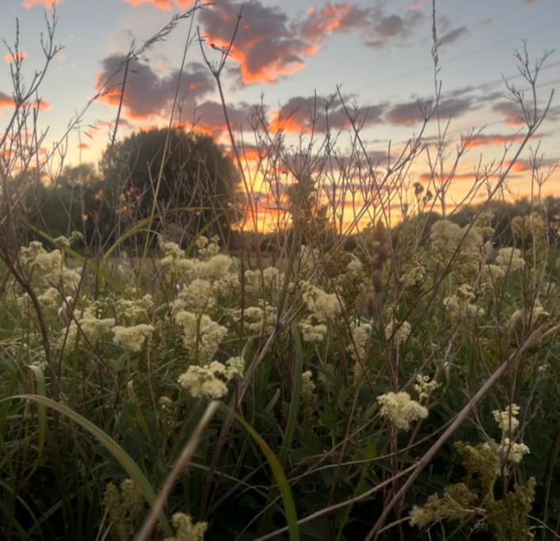

What will be Oxford’s gift to our green King?
“Wildflower meadows are a unique and irreplaceable part of our cultural heritage, no less than Stonehenge and the Rollright Stones.
But floodplain meadows also play a vital and complex role in our 21st century society, and not least in mitigating floods. Their loss is of national and international significance.”
Catriona Bass of the Thames Valley Wildflower Meadow

Slide 62

Don’t let this summer be the last for Hinksey Meadow and The wildlife corridor

